Slide 1
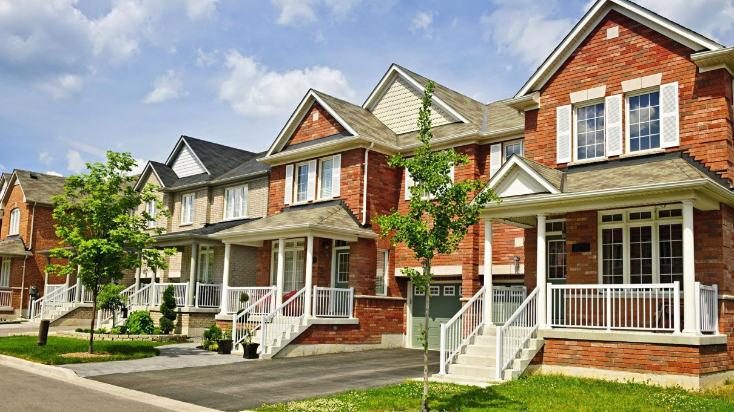
Predictors of Neighborhood Mortgage Acceptance Rates
By
Adam Parente

Slide 2
The Housing Market (2017)
Homeownership Rate of ~64%
~60% of those homeowners have a mortgage
$10.3 trillion in total mortgage debt
$1.75 trillion dollars in mortgages
Over 7.9 million mortgage loans
5.51 million homes purchased
Mortgage access is fundamental to financing home purchases

Slide 3
Home Mortgage Disclosure Act Data
Provided by the FFIEC
2017 data
Neighborhood characteristics
Applicant Characteristics
Mortgage Characteristics
Bias from self selection and dated census metrics

Slide 4
Hypothesis
Does a higher percentage of minority population predict lower rates of acceptance?
2008 market crash had a higher impact on minority housing
Reports that minorities generally had worse mortgage terms
Is this measurable when controlling for other factors like:
Income
Loan size
Housing type
Mortgage type

Slide 5
Summary Statistics
Analyzed at the tract level
~71350 tracts in dataset
Variable | Mean | Std | Min | Max
Mortgage Acceptance % | 0.646 | 0.103 | 0 | 1
Minority Population % | 37.2 | 30.3 | 0 | 100
Median Family Income | 69210 | 15820 | 15800 | 131500
1-4 Family Dwelling Application % | 0.950 | 0.0941 | 0 | 1
Home Improvement Application % | 0.0964 | 0.0757 | 0 | 1
Home Purchase Application % | 0.512 | 0.12 | 0 | 1
Secured by First Lien % | 0.793 | 0.0744 | 0 | 1
Male Applicant % | 0.552 | 0.092 | 0 | 1
Owner Occupied Units per capita | 0.242 | 0.0877 | 0 | 0.718
1-4 Family Dwelling per capita | 0.368 | 0.177 | 0 | 11.4
Avg. Applicant Income | 98270 | 273915 | 16182 | 70080200
Avg. Loan Amount | 246920 | 452120 | 4540 | 92404700

Slide 6
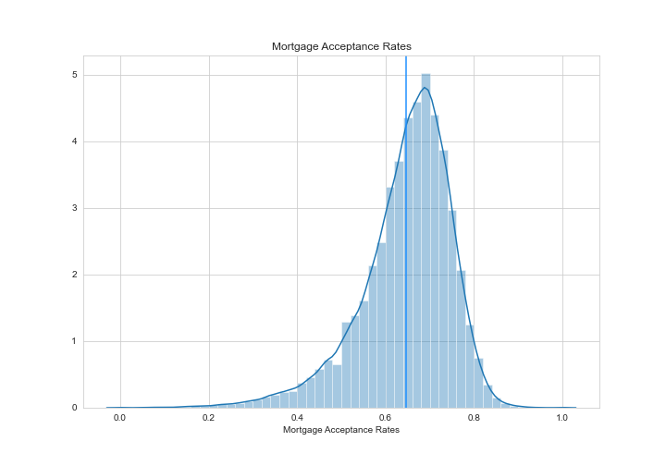
Mortgage Acceptance Rates

Slide 7
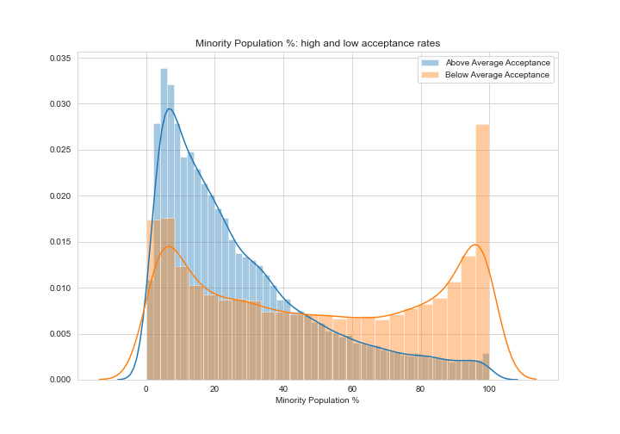
Minority Percentage

Slide 8
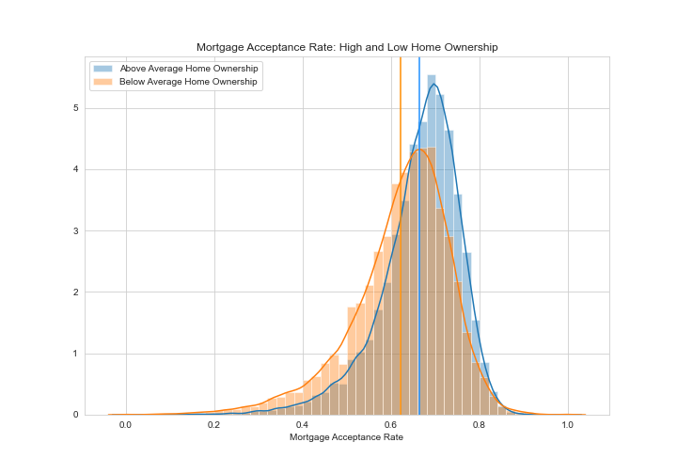
Home Ownership

Slide 9
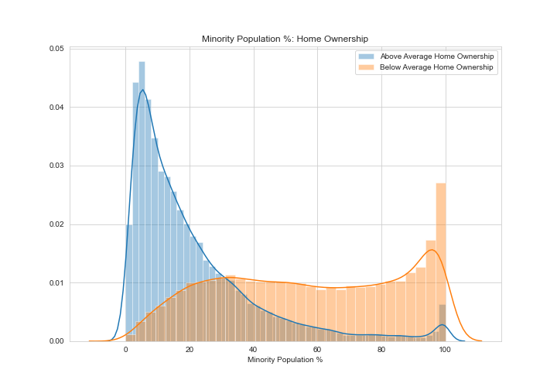
Minority % and Home Ownership

Slide 10
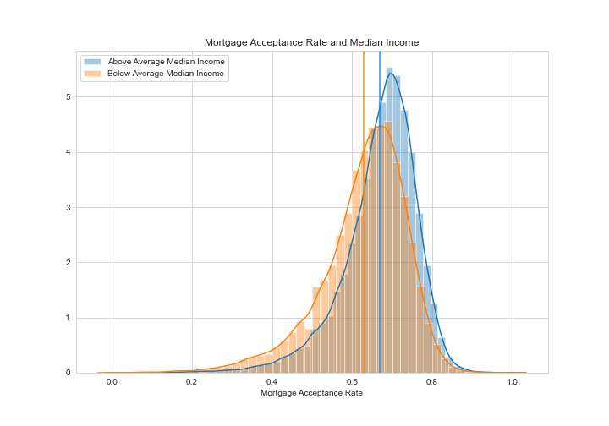
Median Income

Slide 11
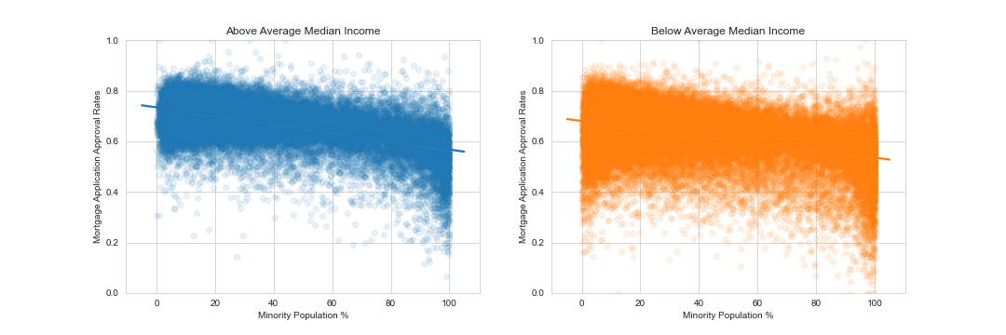
Minority % and Median Income

Slide 12
Importance
Important Variables | Importance (Select K Best) | Importance (Forest)
Minority Population % | 13678 | 0.301414
1-4 Family Dwelling Application % | 11474 | 0.260512
Home Purchase Application % | 5116 | 0.083553
Home Improvement Application % | 9764 | 0.077281
Applicant Income (log) | 6321 | 0.058786
Median Family Income | 4387 | 0.050643
Conventional Loan Application % | 860 | 0.012427
Owner Occupied Units per capita | 2781 | 0.006585
Male Applicant % | 1006 | 0.006008

Slide 13
Coefficients
Key Variables | Coefficients (not scaled) | Std Dev Impact | Coefficients (Scaled)
Median Family Income | -.00000061 | -0.010 | 0.0096
1-4 Family Dwelling Application % | .412 | 0.039 | 0.0387
Applicant Income (log) | -.00054 | -0.007 | -0.0002
Home Purchase Application % | .135 | 0.016 | 0.0161
Male Applicant % | -.040 | -0.004 | -0.0037
Conventional Loan % | .017 | 0.003 | 0.0026
Owner Occupied Units per capita | -.1 | -0.009 | -0.0087
Minority Population % | -.0012 | -0.036 | -0.0361
Home Improvement Application % | -.312 | -0.024 | -0.0236

Slide 14
Conclusion
Variables like home ownership and income account for a portion of the difference between minority and nonminority neighborhoods.
Lower mortgage acceptance rates are still attributable to minority %.
Racial inequality is apparent, but the scale is highly debatable.
The sources of disparities in economic fundamentals are beyond the scope of this project, but they do exist and they do affect mortgage acceptance rates.

Slide 15
Further Research and Improvement
The upcoming census means updated statistics
Additional data on actual rates and terms necessary to analyze predatory behavior
More complete data (fewer unknowns)
More data on mortgages after origination would be valuable in analyzing the health of the overall market

